Slide 1
Title Provide an executive summary for the parking citations for the different LA DOT (Department of Transport) districts. Team Celts: David Mathews Scott McEachern Fiona Weston

Slide 2
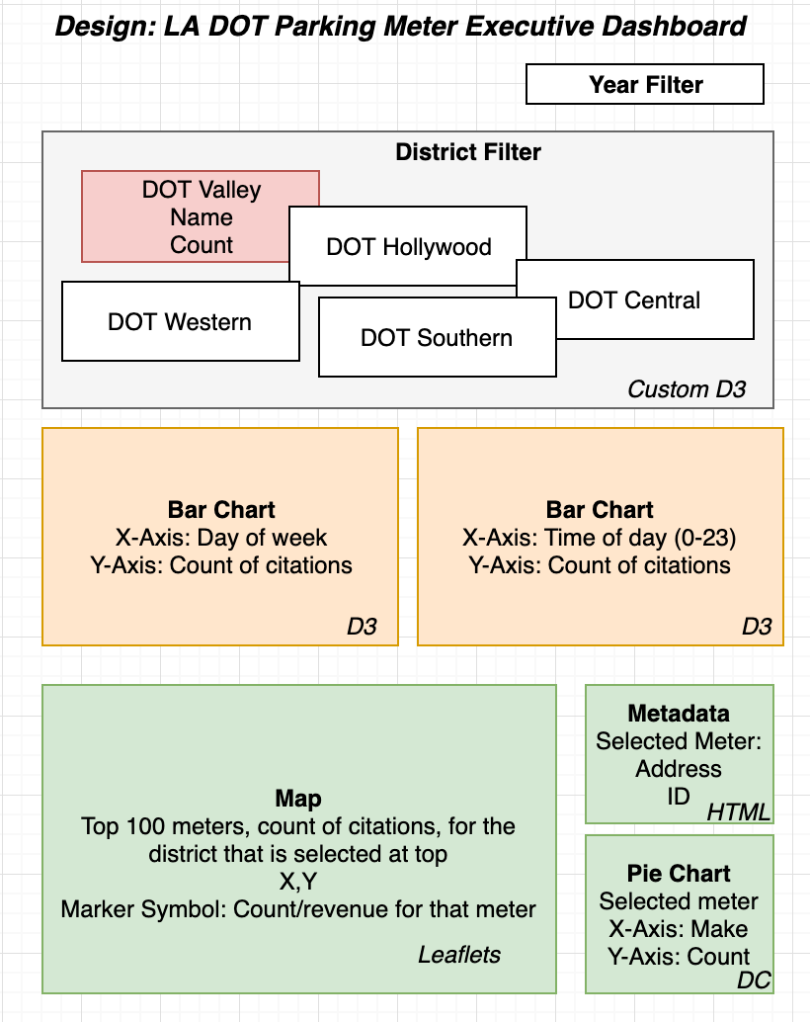
Use Interactive means to tell this story through visualizations
Drop Down: Select the Year
Textboxes: Select the District
Visualizations:
1)Bar Charts: To show relevant numbers.
2)Map to show physical locations

Slide 3
DEMO

Slide 4
Code Approach: Scott
Architecture diagram
Create a diagram ……
Database
REST Endpoints
Structure of client side code

Slide 5
DTO’s: Data transfer Object diagram: David

Slide 6
SQLite How it was created. Grouping and preparing: scott

Slide 7
Endpoints
DAvid

Slide 8
Key visualizations
MAP coustom JS
Separated logic into JS
DAvid

Slide 9
Last DEMO
Fiona

